Slide 1
Strattec Safer-at-Work Policy COVID-19 Milwaukee Operations

Slide 2
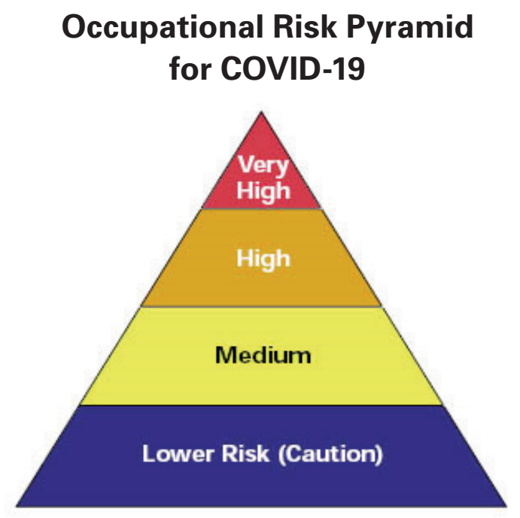
OSHA Guidelines - Classifying Worker Risk to COVID-19
Worker occupational exposure risk to COVID-19 virus may vary from very high to high, medium, or lower risk. Level of risk depends on industry type, need for contact within 6 feet of people suspected of infection, or repeated/extended contact with persons suspected of infection. To help employers determine appropriate precautions, OSHA divided job tasks into 4 risk exposure levels. The OHSA Risk Pyramid shows 4 exposure risk levels to represent probable risk distribution. Most American workers will fall into lower exposure risk or medium exposure risk levels.
Medium Exposure Risk
Medium exposure risk jobs include those that require frequent and/or close contact with (i.e., within 6 feet of) people who may be infected with COVID-19, but who are not known or suspected COVID-19 patients. In areas without ongoing community transmission, workers in this risk group may have frequent contact with travelers who may return from international locations with widespread COVID-19 transmission. In areas where there is ongoing community transmission, workers in this category may have contact with the general public (e.g., schools, high-population-density work environments, some high-volume retail settings).
Lower Exposure Risk (Caution)
Lower exposure risk (caution) jobs are those that do not require contact with people known to be, or suspected of being, infected with COVID-19 nor frequent close contact with (i.e., within 6 feet of) the general public. Workers in this category have minimal occupational contact with the public and other coworkers.
Strattec Classification

Slide 3
OSHA Guidelines – Low Risk (Caution) Classification
What to Do to Protect Workers
For workers who do not have frequent contact with the general public, employers should follow OSHA guidance for “Steps All Employers Can Take to Reduce Workers’ Risk of Exposure to SARS-CoV-2”.
Engineering Controls
Additional engineering controls are not recommended for workers in the lower exposure risk group. Employers should ensure that engineering controls, if any, used to protect workers from other job hazards continue to function as intended.
Administrative Controls
Monitor public health communications about COVID-19 recommendations and ensure that workers have access to that information. Frequently check the CDC COVID-19 website: www.cdc.gov/coronavirus/2019-ncov.
Collaborate with workers to designate effective means of communicating important COVID-19 information.
Personal Protective Equipment
Additional PPE is not recommended for workers in the lower exposure risk group. Workers should continue to use the PPE, if any, that they would ordinarily use for other job tasks.

Slide 4
Strattec Protection Plan – Milwaukee Operations
Controls Already Implemented:
Enhanced cleaning/disinfection procedures.
Social distancing/limiting group sizes.
Visitor signed health self assessments reviewed by our security team.
Building access limitations put in place to eliminate bypassing of security team/health assessments.
Requirements of associates to report illness & stay home if they are sick without attendance points.
Voluntary layoffs allowing any associates that may be high risk or uncomfortable to stay at home.
Requiring non-essential associates to work from home if possible.
Processes for quarantining potentially infected areas & associates if someone is suspected of the virus.
Review of all work areas to ensure minimum distances are maintained.
Additional Controls In-Process:
Distribution of cloth face coverings/masks to each Milwaukee associate provided by Strattec.
All associate temperature screenings using an infrared camera near security office entrance.
All associate signed health self assessments each day reviewed and retained by supervisory team.
Special handling of incoming packages per OSHA guidelines.

Slide 5
Strattec Protection Plan – Milwaukee Operations
Personal Protective Equipment (PPE)
Normal PPE is still required for entire manufacturing areas including safety glasses, hearing protection, closed-toe shoes, et.
It is highly recommended and encouraged for all associates to wear protective face coverings.
In situations where direct contact with individuals or surfaces is probable, PPE for handling blood borne pathogens should be utilized which includes face coverings, safety glasses, Tyvek suit and rubber gloves.
Additional Considerations:
Continue to work safely and maintain safe distances of greater than 6 feet from other associates.
Remember that a mask is not a replacement for safe distancing guidelines.
Regardless if you wear a mask or not, you must adhere to safe distancing guidelines.
Be extremely diligent about washing hands frequently with soap and water, and not touching your face.
Stay home if they are sick! Avoid others if they appear sick.
Adhere to respiratory etiquette – Cover all coughs and sneezes!
Do not allow others to use your phone, desk, or other work tools and equipment, whenever possible.
Maintain regular housekeeping practices, including routine cleaning and disinfecting of your work surfaces/equipment and other elements of the work environment in which you may contact.
Avoid touching unnecessary surfaces as much as possible.
Minimize in-person meetings to 5 people if possible, and maintain safe distance during entire meeting.
Do NOT shake hands, hold hands, hug or make direct contact with any other associates.

Slide 6
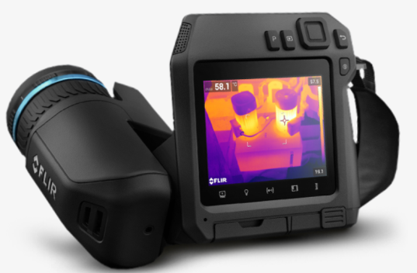
Strattec Protection Plan – Milwaukee Operations
Temperature Screening:
Strattec has purchased an infrared camera which measures temperatures. Due to high demand, we are expecting it to arrive in early June, at which point, we will implement specific procedures for this process.
Health Self Assessment Questions:
Self-assessments must be completed before starting work and turned into direct supervisor after punch in.
If an associate refuses to complete the self assessment, the company will ask the employee to leave the job, obtain and provide medical clearance before returning to the company's premises.
Identify any close contact with a confirmed or suspected case of COVID-19.
Notify of any travel outside of the state in the last 14 days.
Disclose any of the following symptoms:
Fever above 100F
Shortness of breath or difficulty breathing
Dry cough or sore throat
Loss of taste or smell
Daily Health Assessment Observational Tours:
Supervisors and EH&S team to conduct health assessment tours during the day checking for:
Safe Distancing & observing for obvious symptoms such as coughing, shortness of breath and proper use of PPE.

Slide 7
Strattec Protection Plan – Milwaukee Operations
Quarantine/Isolation Procedures:
Any employee with symptoms of COVID-19 should be escorted to the Medical office and immediately provided with a facemask and nitrile gloves.
The First aid associate will wear face mask, Tyvek suit, nitrile gloves & safety glasses prior to examining employee and completing the COVID-19 evaluation form. If suspected of COVID-19, First Aid will inform the associate’s direct supervisor and the quarantine will be logged/contacts can be traced by HR.
Once in "quarantine" employees must remain outside the company for 12 days, or have a written release by a medical doctor. Human Resources will follow up with symptomatic employees before or during this period.
The area supervisor must send the sick employee home or to the nearest Health Center:
If the infected person is well enough to drive their own vehicle, ask them to use it. Public transport should not be used.
If associate must be driven by company vehicle, ensure infected person always wears a face covering & nitrile gloves. Driver must wear face covering & nitrile gloves for entire trip including the return for proper disposal. After returning, clean/disinfect all surfaces, seats, dashboards, door handles, seat belts, et. Face covering, gloves and safety glasses must be worn while cleaning vehicle.
Human Resources (HR), in coordination with the associates direct supervisor and EH&S, must:
Identify people who may have come into prolonged close (<6 feet & >15 minutes) contact with the suspected infected employee.
Notify associates, who may have been in contact with a suspected infected employee & place them in self-quarantine for 12 days.
Employees must have EH&S and HR clearance to return to work.
Make sure that both the medical room and the suspect associates work areas are thoroughly cleaned/disinfected, along with all other common surfaces touched by the infected employee.
Isolate the work area, using cones and “do not enter” tape.
Clean machines, tools, and support equipment with bleach solution or 70% or > alcohol.
The cleaning team must wear face covering, nitrile gloves, Tyvek suit and safety glasses while conducting any cleaning.

Slide 8
Strattec Protection Plan – Milwaukee Operations
Enhanced Cleaning/Disinfection Procedures:
General Procedure
Daily disinfection of all common areas and surfaces such as conference room tables, doorknobs, light switches, handles, handrails, toilets, faucets, kitchenettes, and sinks.
If surfaces are dirty they should be cleaned using a detergent or soap and water prior to disinfection.
Wear disposable gloves, face mask, Tyvek suit, and safety glasses for all tasks in the cleaning process.
70% or greater alcohol solution per CDC:
Spray surfaces until saturated and wipe the area down while still wet.
Spray surfaces again until saturated
Allow everything to air dry for at least 1 hour
Personal protective equipment and cleaning supplies to be disposed of after use.
Do not use Alcohol solution on any touch screens, use a soft cloth for screens and displays with only enough of the disinfecting agent as to not have liquid run down the screen during cleaning.
Bleach solution (1/3 cup(2.68oz) per 1gallon of water) per CDC:
Spray surfaces until saturated and let sit at least 1 minute
Wipe the area down while still wet
Allow everything to finish air drying for at least 3 hours
Do not use bleach solution on any touch screens, use a soft cloth for screens and displays with only enough of the disinfecting agent as to not have liquid run down the screen during cleaning.
Dispose of all cleaning materials, and disposable PPE in a trash can
Wash hands immediately after disposal on materials and PPE.

Slide 9
Strattec Protection Plan – Milwaukee Operations
Visitor/Contractor Procedures:
Visitors and contractors must complete and turn in self assessment to security before they will be permitted into the facility.
Visitor/Contractor Personal Protective Equipment (PPE)
Safety glasses at all times if they enter the plant.
Face coverings/masks are required for any non-Strattec associates.
While on site:
Use your personal protective equipment at all times.
Respect the Safe Distance.
Entry only authorized areas

